Slide 1
McGregor Backyard Roller Coaster Company
Development of Eight-Wheel High-Weight 3D Cart
BYRCcart-3D-07
January 2015
Paul Stevenson Gregg, Chief Engineer
McGregor Backyard Roller Coaster Research Institute

Slide 2
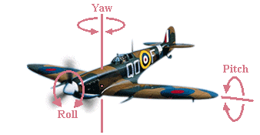
Roll, Pitch, and Yaw

Slide 3
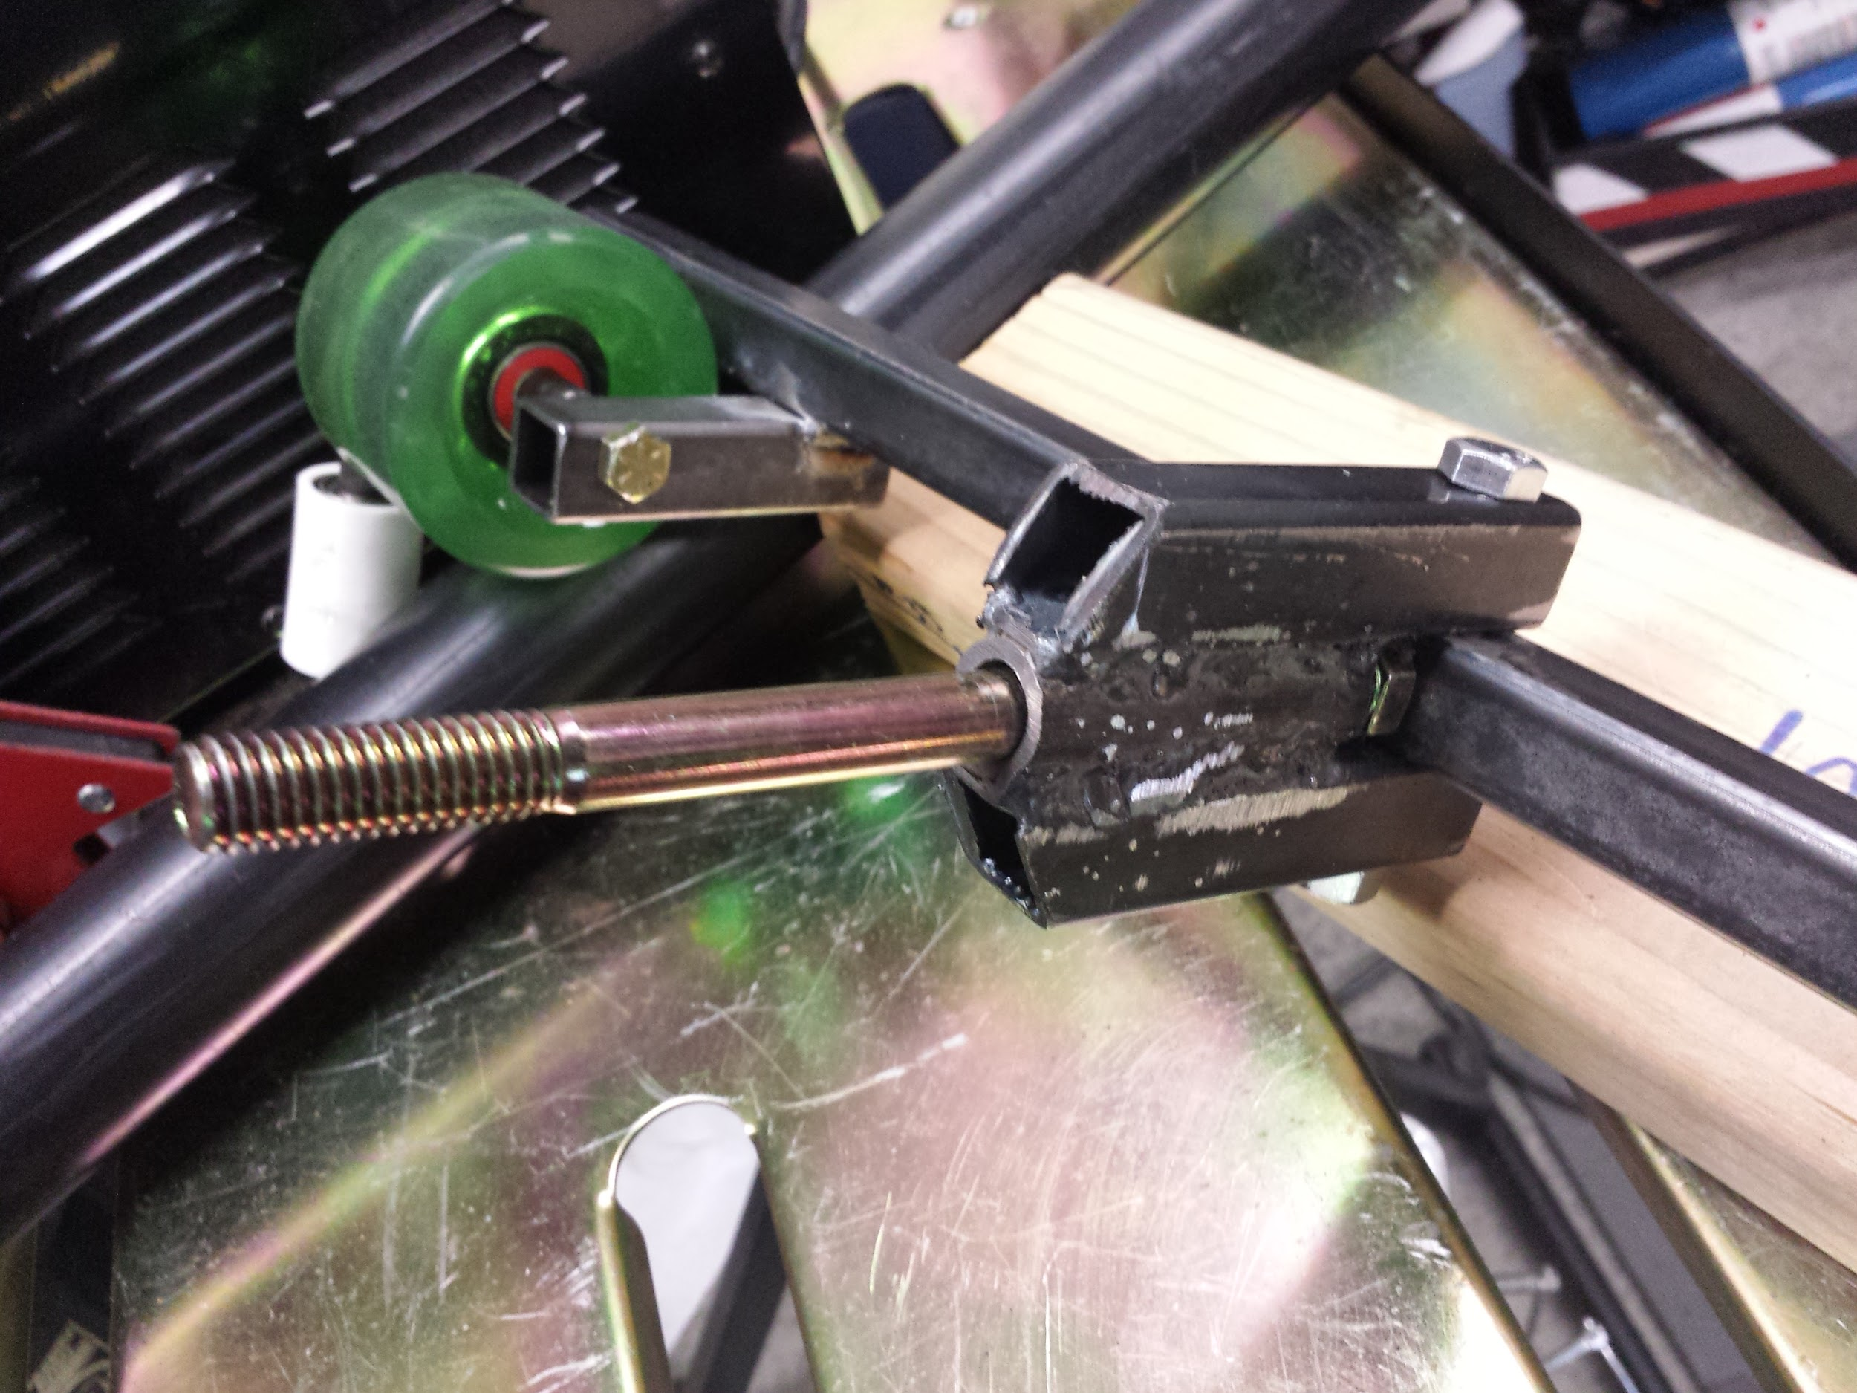
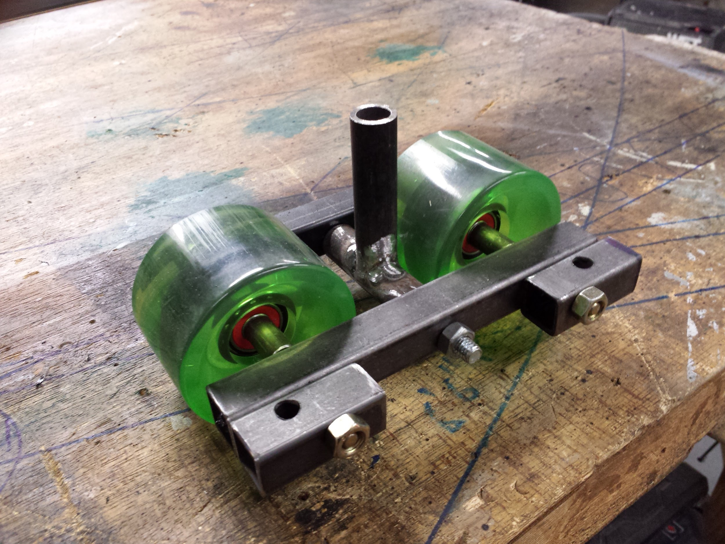
The reason I’ve tried to use only 4 wheels instead the standard 8 is to keep the mass of my wheel assemblies down, so the inertia is lower, so less energy is used in turning the wheel bogies. A “bogie” is defined as the left and right wheels (or wheel sets - trucks), connected by a cross bar. However, the load per wheel is twice as high with only 4 wheels vs 8. I would like to increase my load capability, and will probably design and build an 8-wheel cart this winter of 2014, for use on the 3D-02 track.
One drawback to the single wheel design is that the side wheels do not track orthogonal to the rails, which is a source of sideslip drag. But, I made my side wheels out of PVC couplers, so the drag would be minimized. Two-wheel truck assembly side wheels will track orthogonal to the rails. Both single wheel, and 2-wheel trucks pitch feely.
I already designed and built a 2-wheel truck assembly in August 2014, but set it aside while I pursued the 4-wheel cart. So it should be pretty simple to attach that design to a front cross bar and incorporate the same yaw- and roll- pivot joints as the 3D-02 cart, only on a new cart. I would also like to further develop an aft bogie concept, replacing my successful “Ackermann” style aft end on the 3D-02 cart. I’ll probably use different, harder wheels as well. I’ve been looking, and the make hard skateboard and skate wheels, 101a shore hardness seems pretty hard.
FWD
front yaw- and roll-pivot joints
two-wheel truck assembly

Slide 4
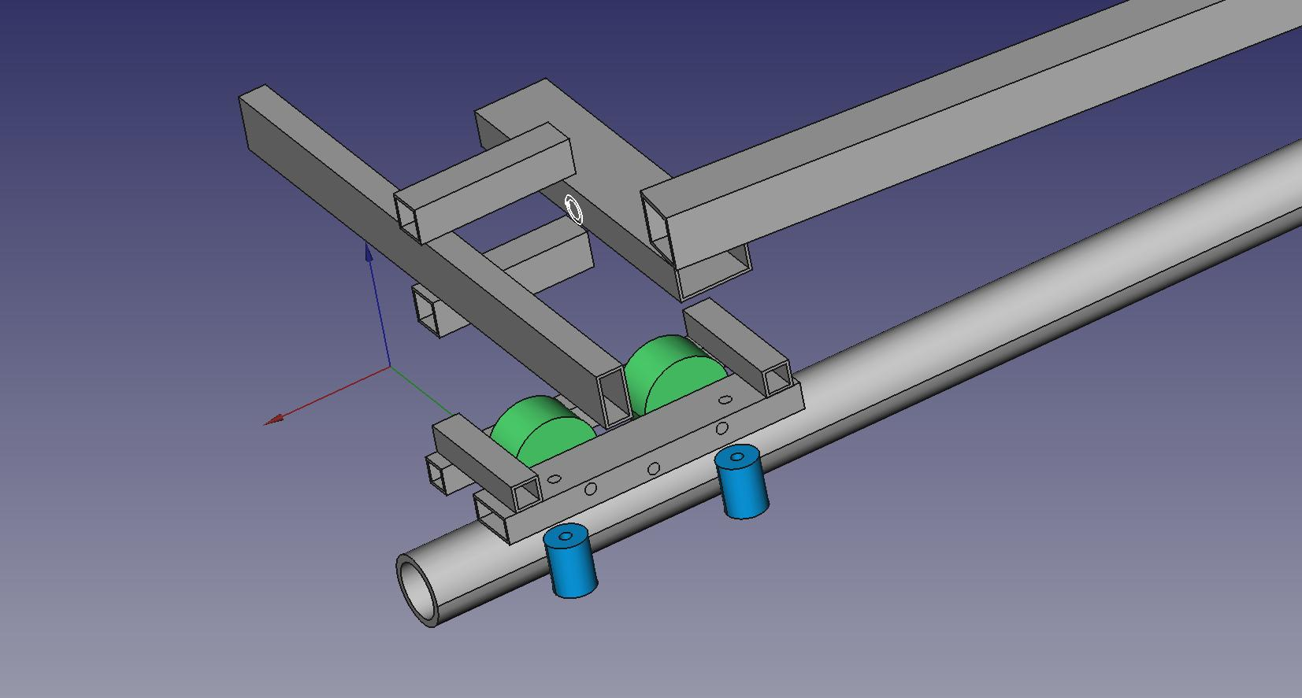
BYRCcart-3D-03 Truck/Bogie Design
in FreeCAD v0.14

Slide 5
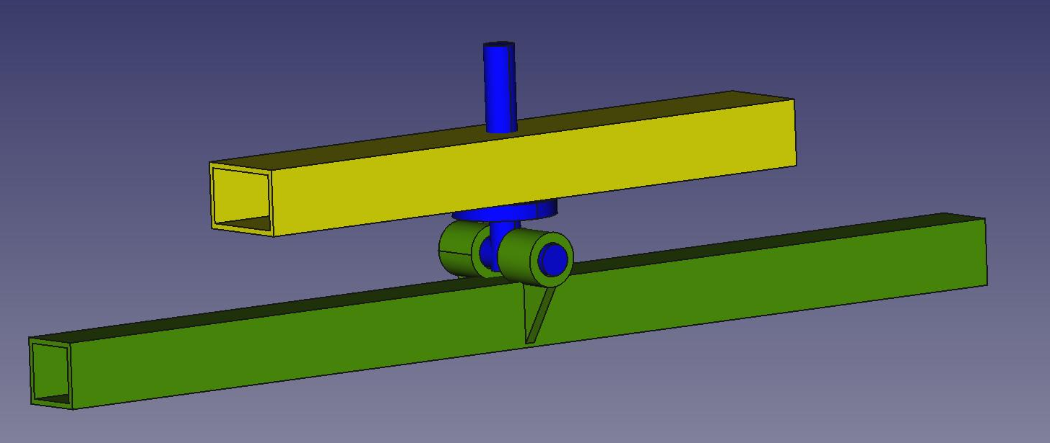
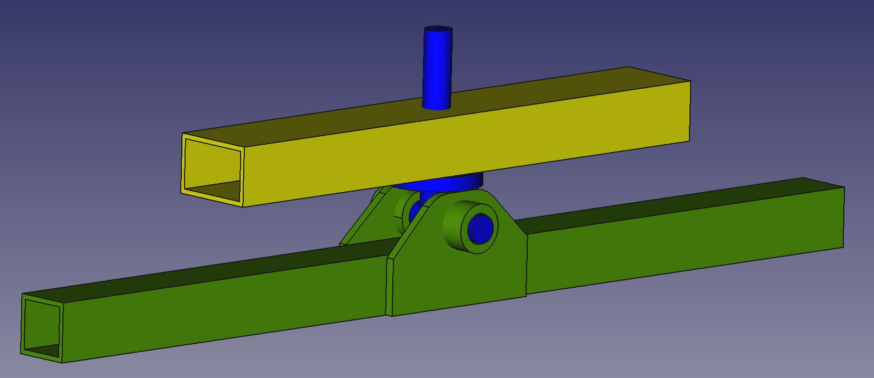
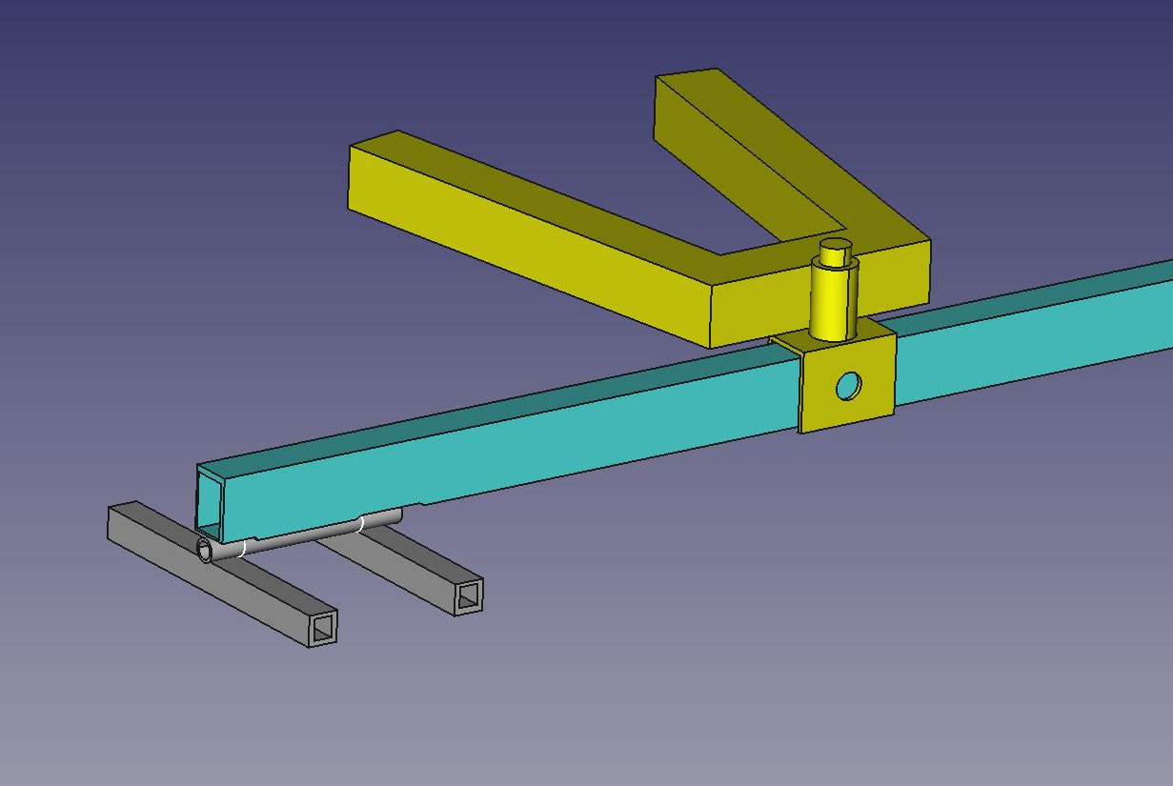
Ujoint004
Ujoint005
Ujoint007
Ujoint008
Universal (front end roll and yaw DOF) Joint Ideas
Design is an iterative process. I will usually think about load path and required function, check out other people designs online, then come up with 5 to 10 increasingly better solutions.
I think becoming a good designer involves a lot of experience. I’m not sure design is something you can teach line analysis.
Some of the best designers at Boeing I’ve known came over from England (the Avro Company - Avro Lancaster Bomber) after WW2. I asked one of the best of those old designers about his education in England. They had to complete two years in a machine shop before they could take their first engineering course. This made a much better engineer.

Slide 6
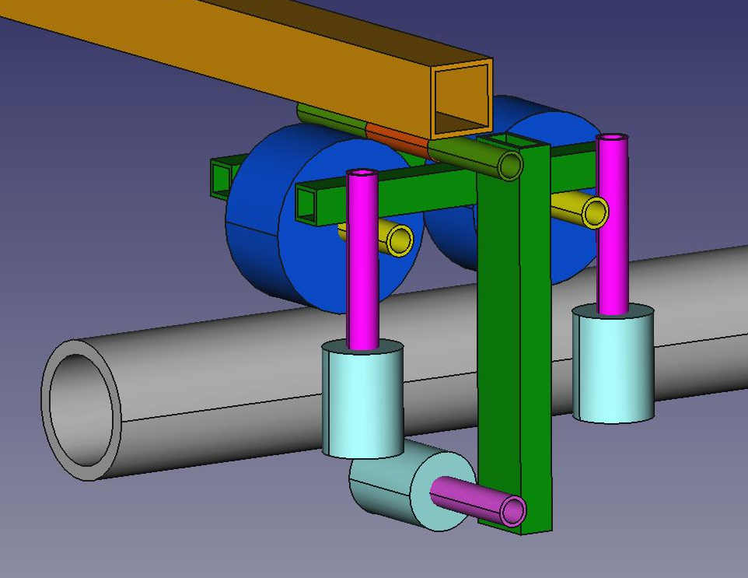
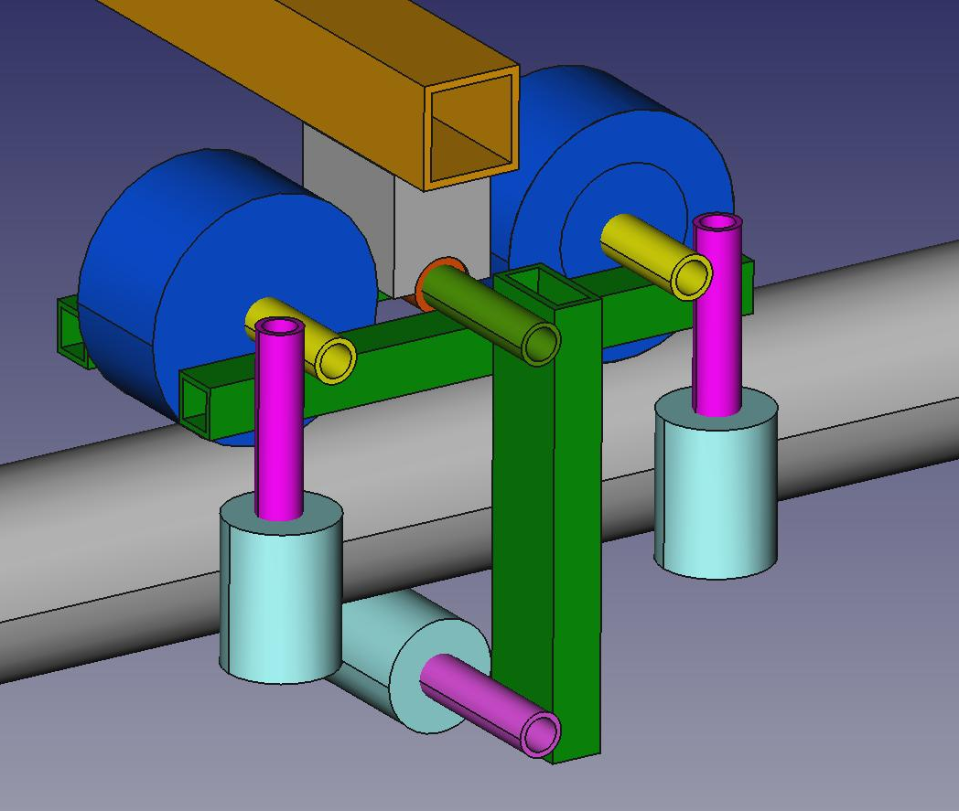
BYRCcart-3D-04 Front Bogie
BYRCcart-3D-05 Front Bogie
new concepts, making more use of sleeves welded to faces. I like the welded sleeve concept, as you don’t reduce the strength of the truck parts by drilling holes in them.
I calculated the stress on the small ½” by ½” by 0.060” frame member, and predicted a high margin.

Slide 7
BYRCcart-3D-06 Wheel Assy
tack-welded truck
frame is ½” by 1” tubes (0.062” thk)
Final truck design ?
This design has all the features I’ve been thinking are important:
1) dynamic stability via load introduction axle slightly lower than, and in front of, wheel axles
2) bolted and welded design
3) axle sleeves fillet welded to outsides of frame
4) small, light side wheels so they will spin up rapidly
5) hard a101 main wheels, precision bearings on main wheels
6) loose bearings on side wheels
7) as light as possible so less energy is used turning the bogie back and forth through turns (higher responsiveness)
8) fillet welds i/s/o butt welds
9) pitch-pivoting wheel truck so side wheels track orthogonally

Slide 8
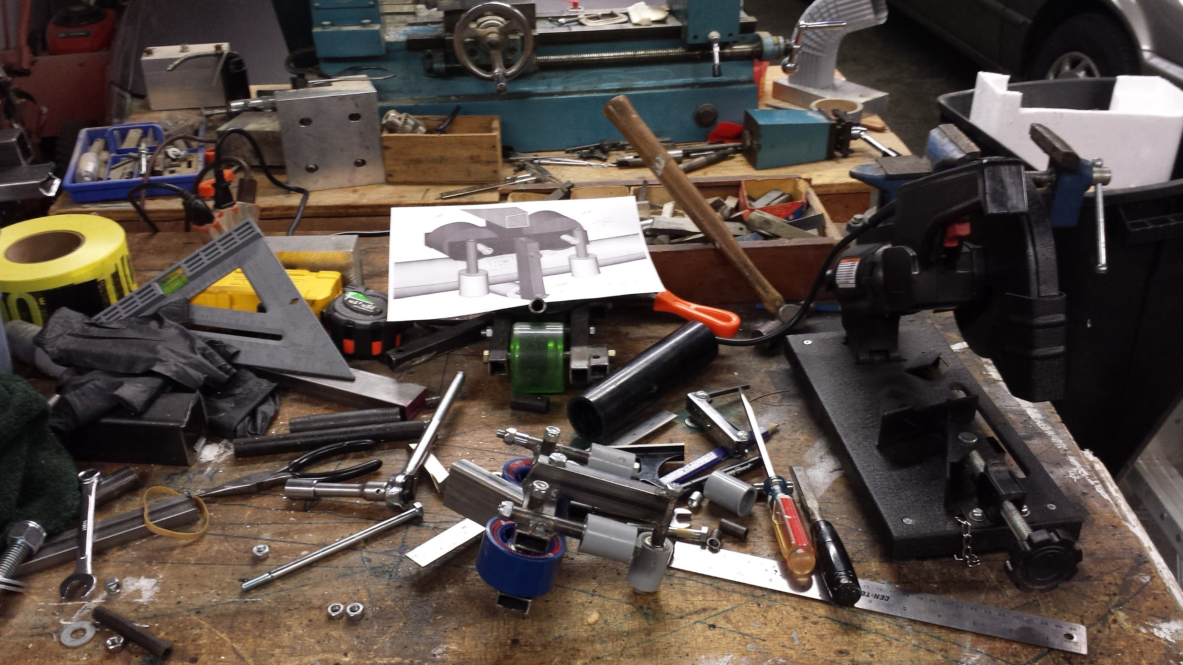
My workbench

Slide 9
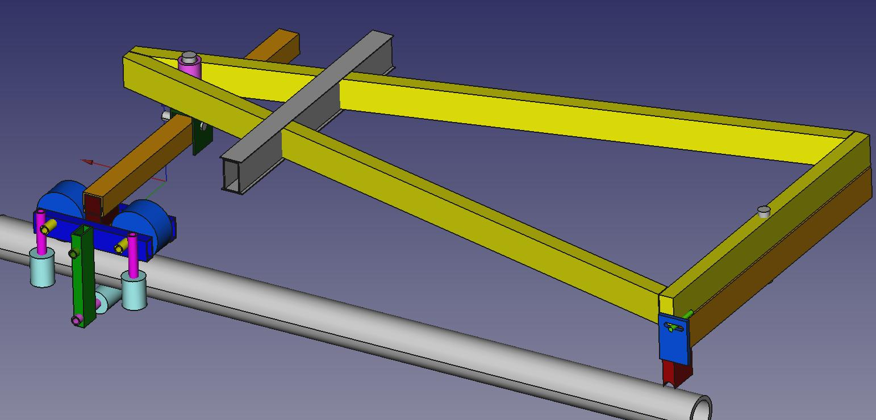
BYRC-cart-3D-06 Design

Slide 10
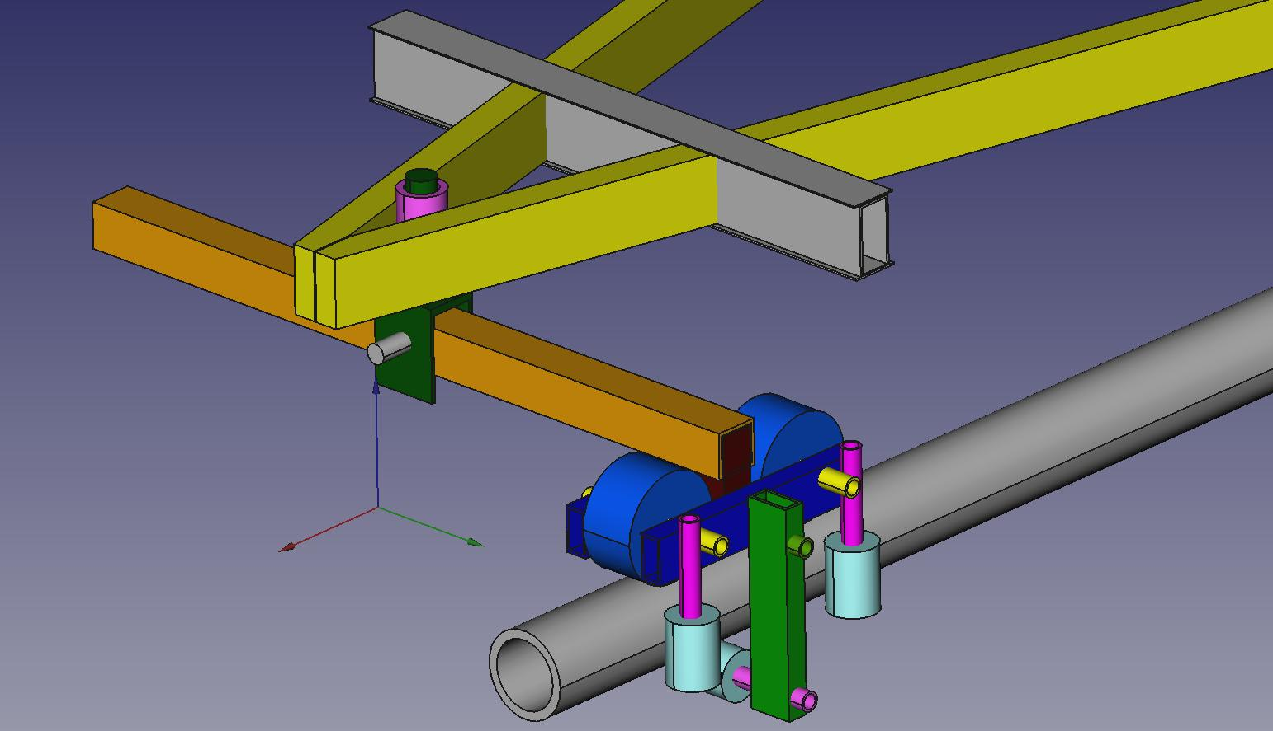
BYRC-cart-3D-06 Front End
Fore-aft angled frames are uninterrupted. Cross frame formed by three pieces of ¾” by 1-½” rectangular tube and two welded caps

Slide 11
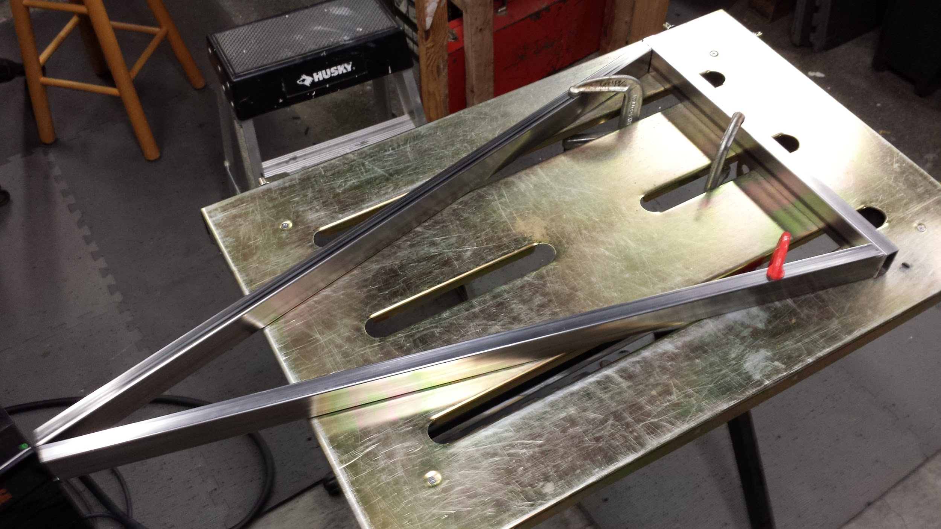
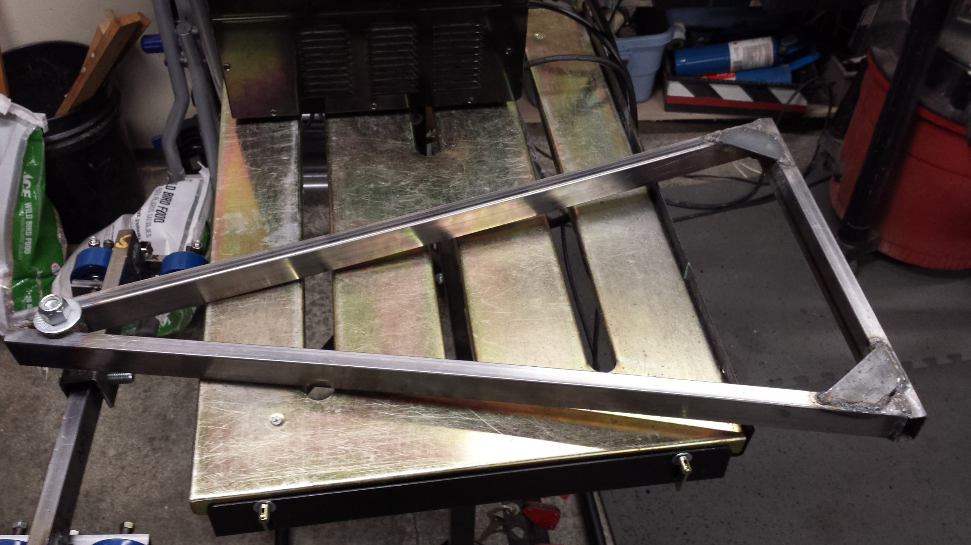
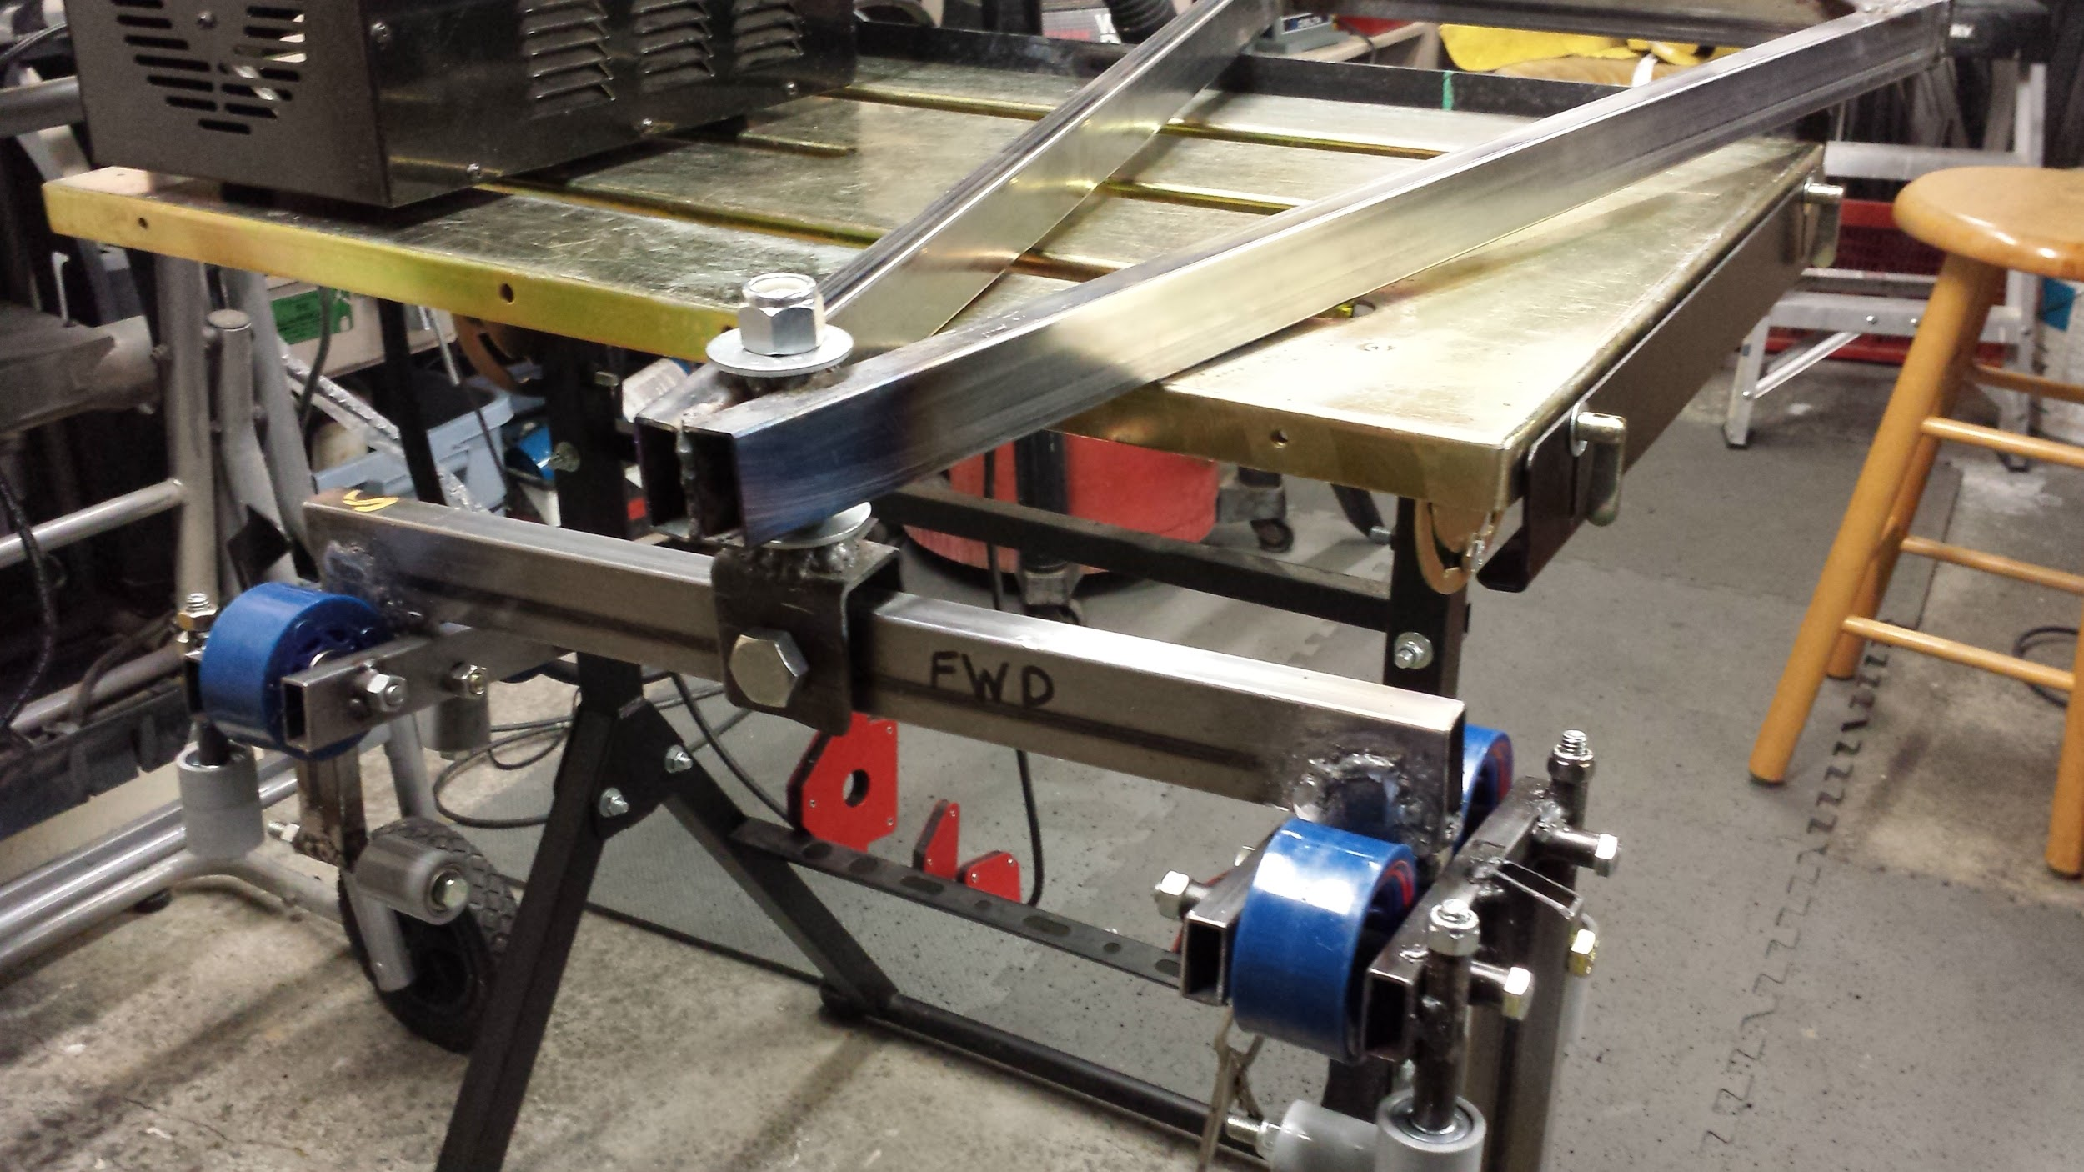
frame clamped to welding table
corner gussets added to improve strength and stiffness - shear and compression weld load paths are preferable to tension
Using a 3D computer aided design (CAD) program, or having good 2D drawings, helps a lot when you start cutting detailed pieces which will fit into an assembly, as you have all your lengths and cut angles already figured out.
welded and assembled front end

Slide 12
To avoid butt welds in a critical load path, I welded on four small strips (we call them doublers) between the bogie cross bar and the stanchions which interface with the trucks. The fillet shear welds got a little messy, but it will be very strong. Since these were not in the CAD model, they crowded the front wheels, so I had to grind the front-side strips down to assure the front wheel can spin freely when the truck is on an up slope. I would have spread the wheels apart a little more in the CAD model to allow for these reinforcing strips, if I’d thought of it earlier.
Some people nowadays think you can fully engineer a product on a computer, with no mockup fabrication and test. But I have found there’s still great benefits to hands on hardware and physical testing. Many times, good computer aided design and analysis can take longer and cost more than fabrication and test, if you can get to the hardware stage early. On the other hand, once you’ve made the hardware, it’s a lot more difficult to change than a CAD model.
So a combination of virtual design/analysis and physical fabrication/test is best, and you’ll find that they compliment each other.

Slide 13
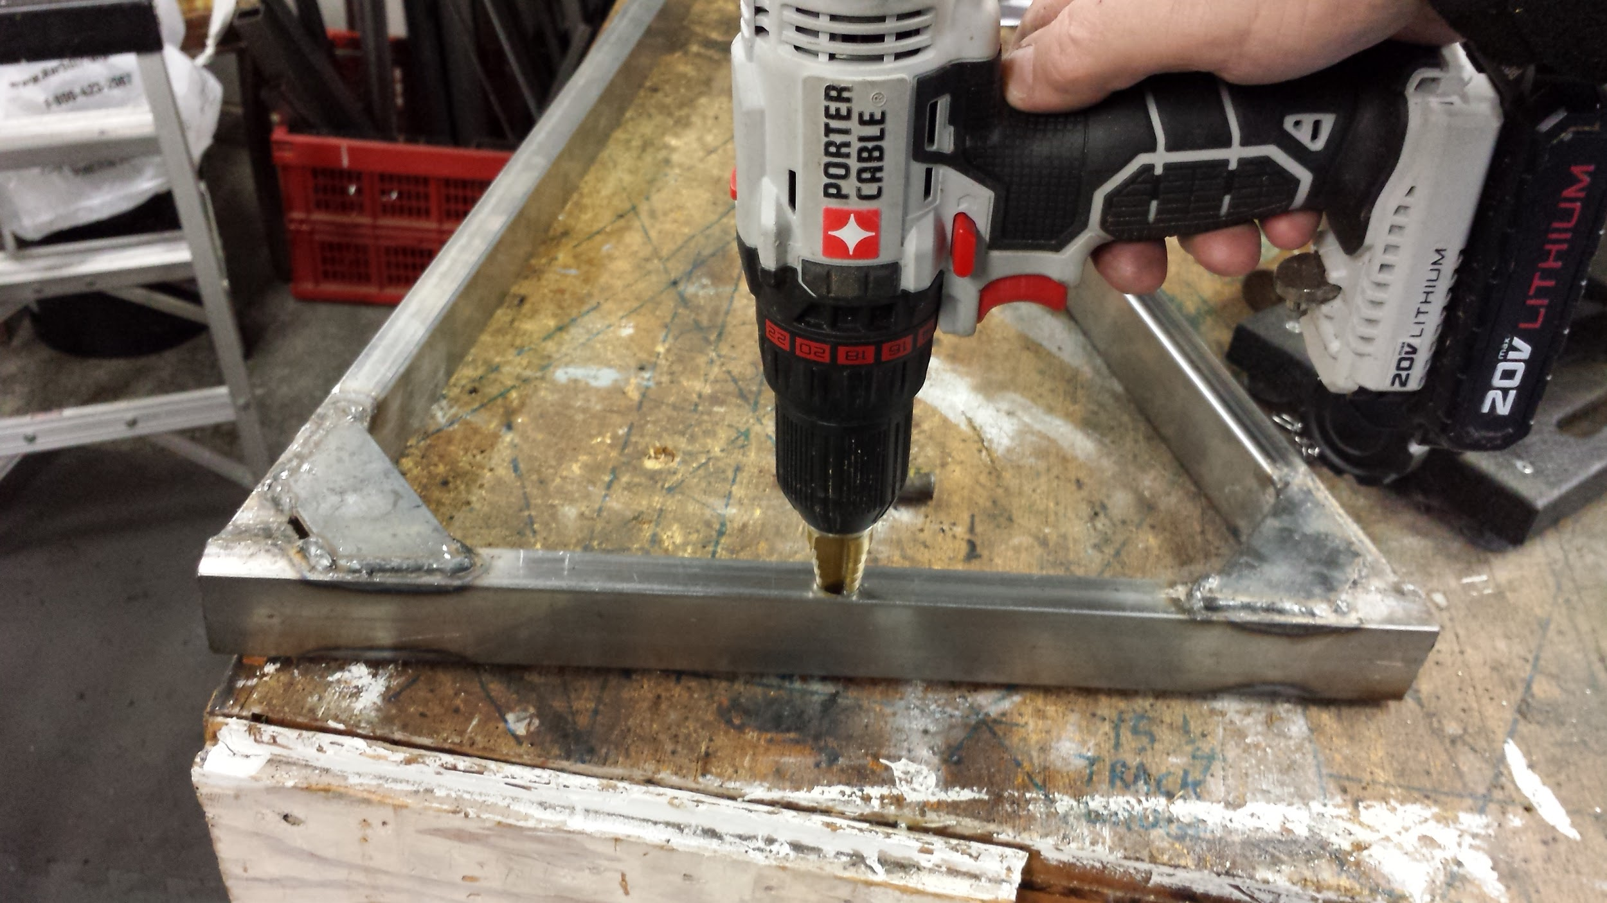
I was having a very hard time drilling larger holes in steel with my normal drill bits, so I tried a step drill, which works well in the drill press or with a hand drill, if you first drill a ½ inch pilot hole, which you need to do first anyway, so both holes in a hollow tube are coaxial (lined up).

Slide 14
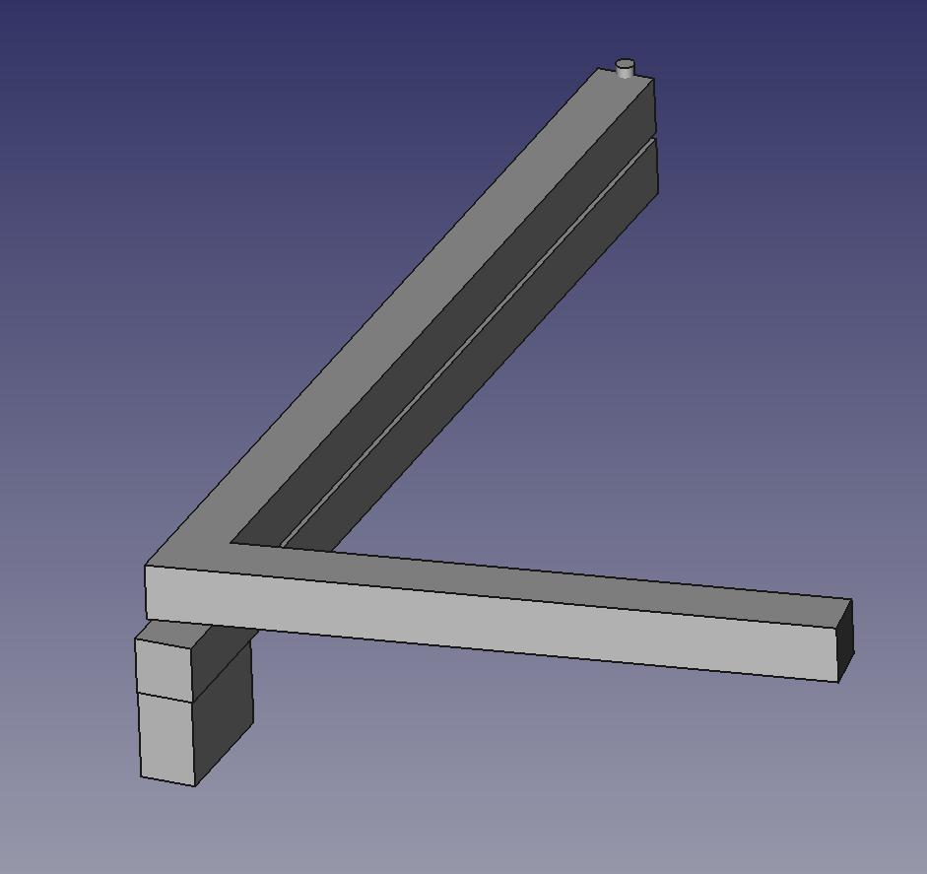
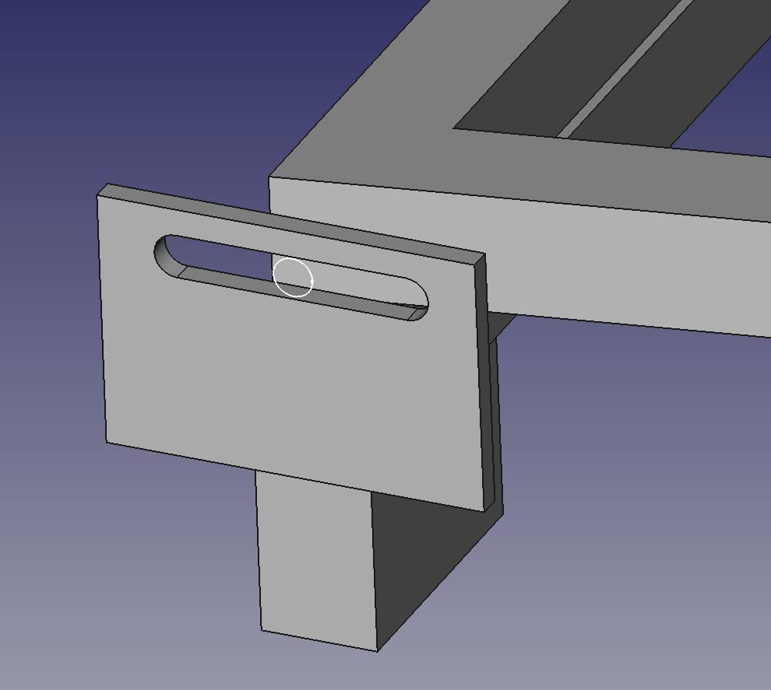
One unsolved problem is how to react the overturning roll moments produced in turns. The front bogie intentionally cannot react roll moments, by design, so the aft bogie has to react all roll moments into the aft wheels and track.
Problem - how to react roll overturning moment, while allowing the aft bogie cross bar to pivot freely in turns
I could try teflon tape between the two bars, or just grease, and react the moment between the pivot and the bearing surface.
Or, this is a possible slotted plate design to react roll overturning moments over twice the distance (plate to plate) without generating friction between aft frame and aft bogie cross bar. Use a hard pin of a different material, to prevent galling, and use moly grease.

Slide 15
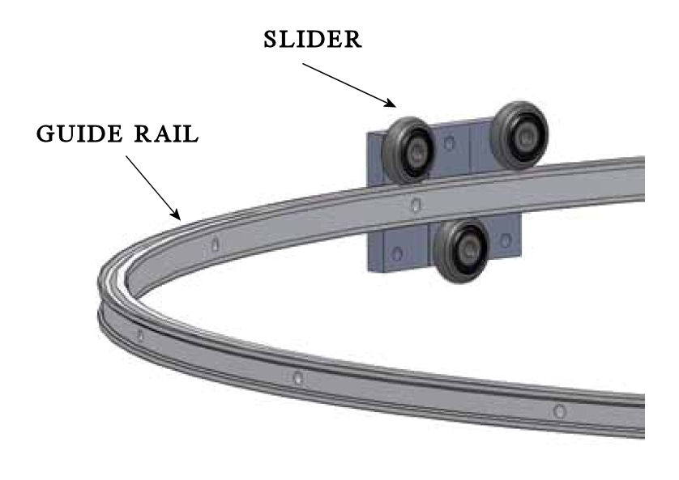
BYRC-cart-3D-06 Aft End Ideas
Alternative method of restraining roll overturning moments via aft wheel bogie
Will this allow aft bogie yaw freedom, and still react roll overturning moments? Maybe the pin should be in a sleeve attached to the aft frame, to allow it to spin.
The two guide rails would be short, with one at each end of the aft bogie crossbar. Two interfacing sliders would attach to the frame aft crossbar.

Slide 16
one bearing
two bearing
Linear (circular) bearing in a channel idea:
Use a standard 8X22X7 mm bearing(s), on a rod(s) attached to the aft frame, inside a channel attached to the aft bogie crossbar.
This will allow the aft bogie to react roll overturning moments, and still allow aft bogie yaw pivoting, with a minimum of friction.
The channel can be made by welding a channel and a strip, or by welding two angles.

Slide 17
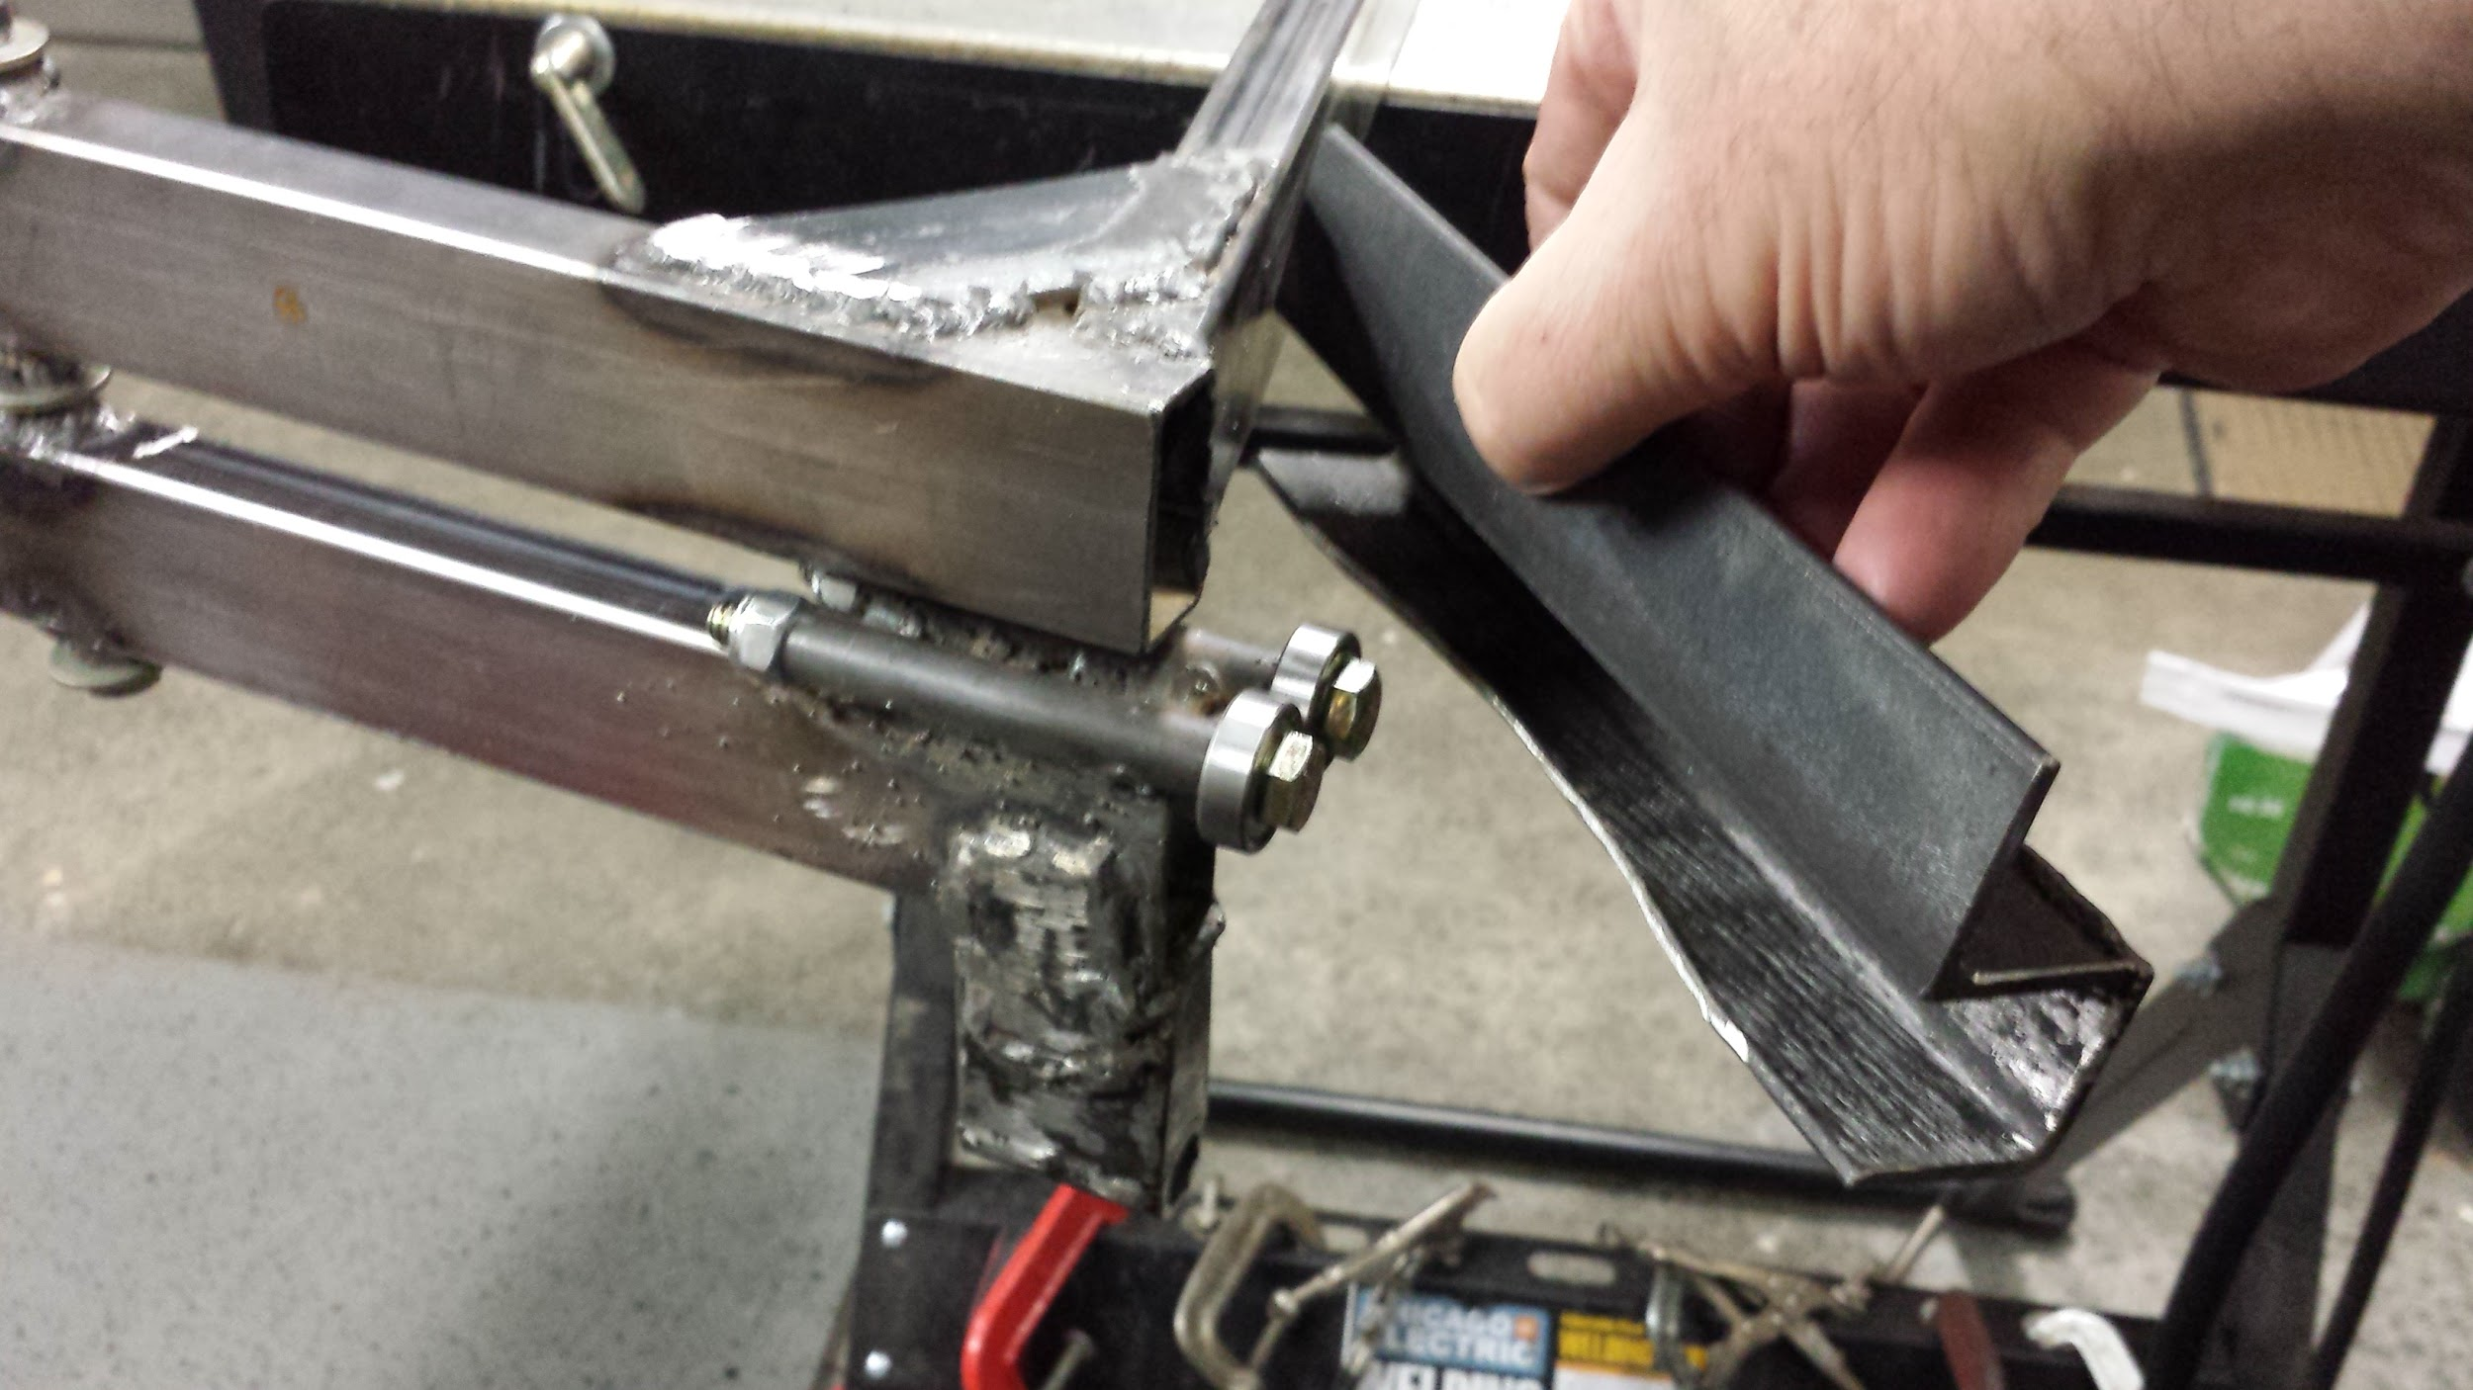
I ended up welding the anti-roll channel on the cart frame, not the bogie, as this will keep the weight of the bogie down, so it will be more responsive and consume less energy when it turns. I had to cut an arc in the lower channel so the bogie didn’t interfere with it, which wouldn’t be necessary if I had thought of this earlier and made the frame a little wider.
I used fillet-welded sleeves to hold the anti-roll bolts and bearings. Two bearings will help react pitch loads.

Slide 18
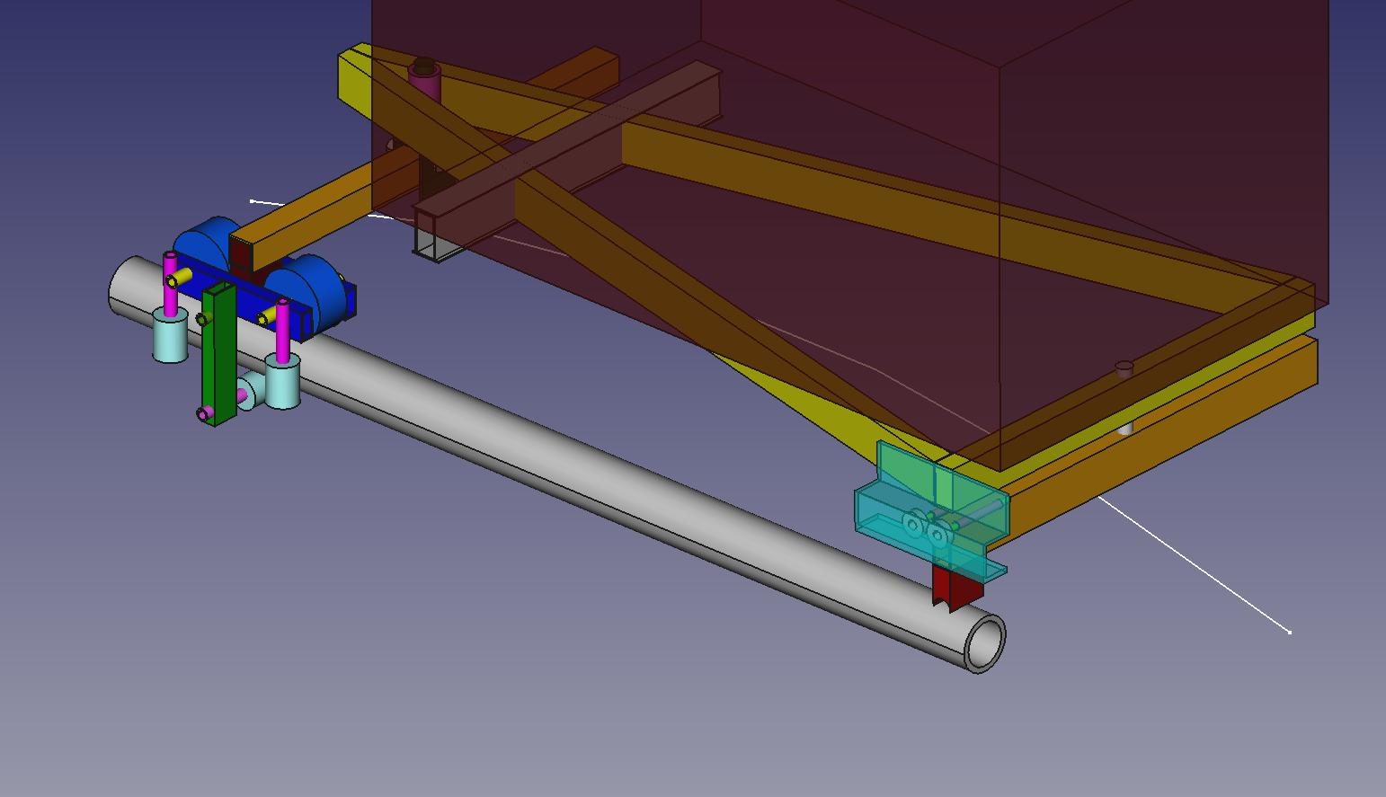
Fabricated (final) design
BYRC-cart-3D-07
Everything looks pretty good, but it does stand fairly tall off the tracks. I used 0.063” thick ¾” by 1-½ “ rectangular tube for the main frame and bogie cross bars.

Slide 19
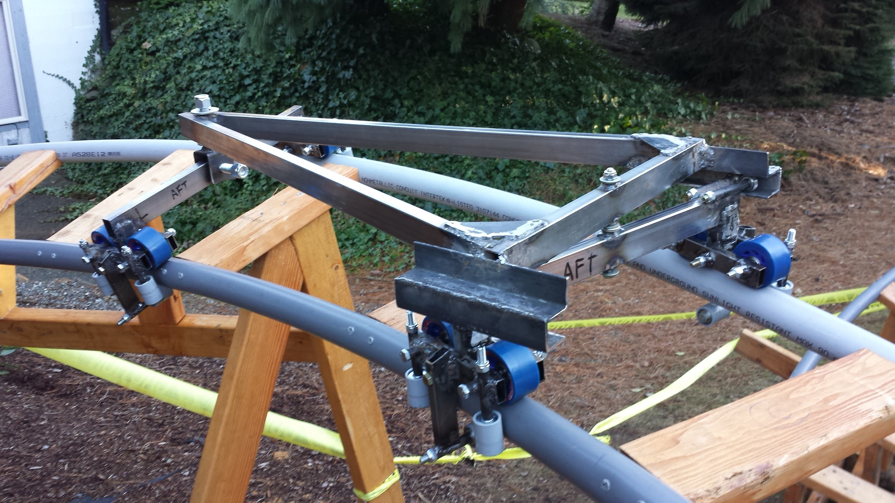
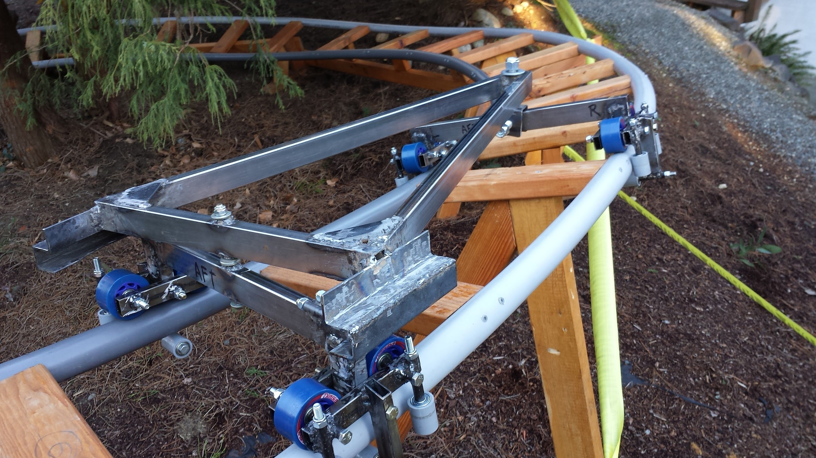
The new -wheel cart zips around the 3D track well, but really no better than the four wheel cart. The bare frame weighs 20 pounds.

Slide 20
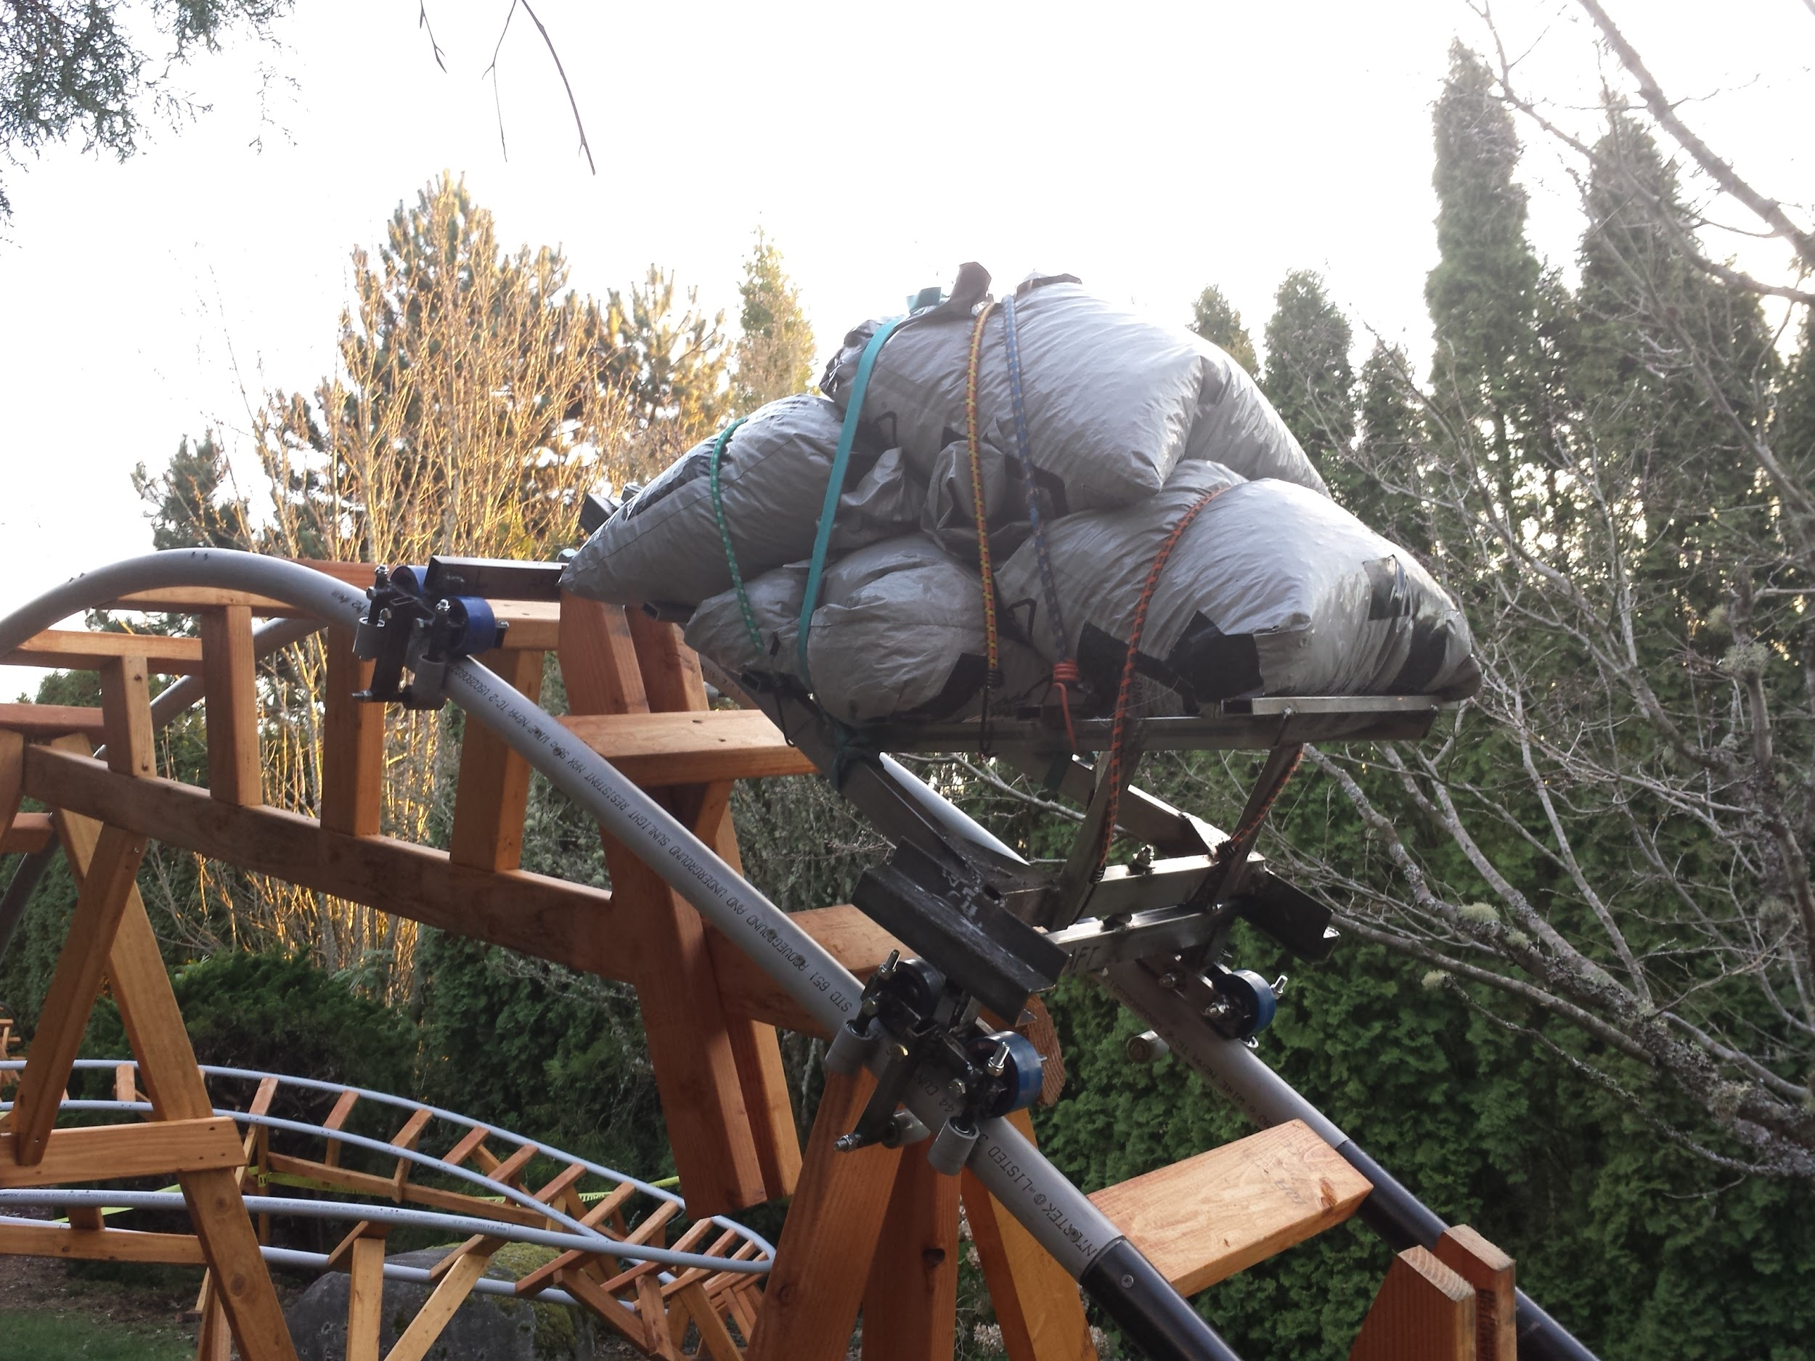
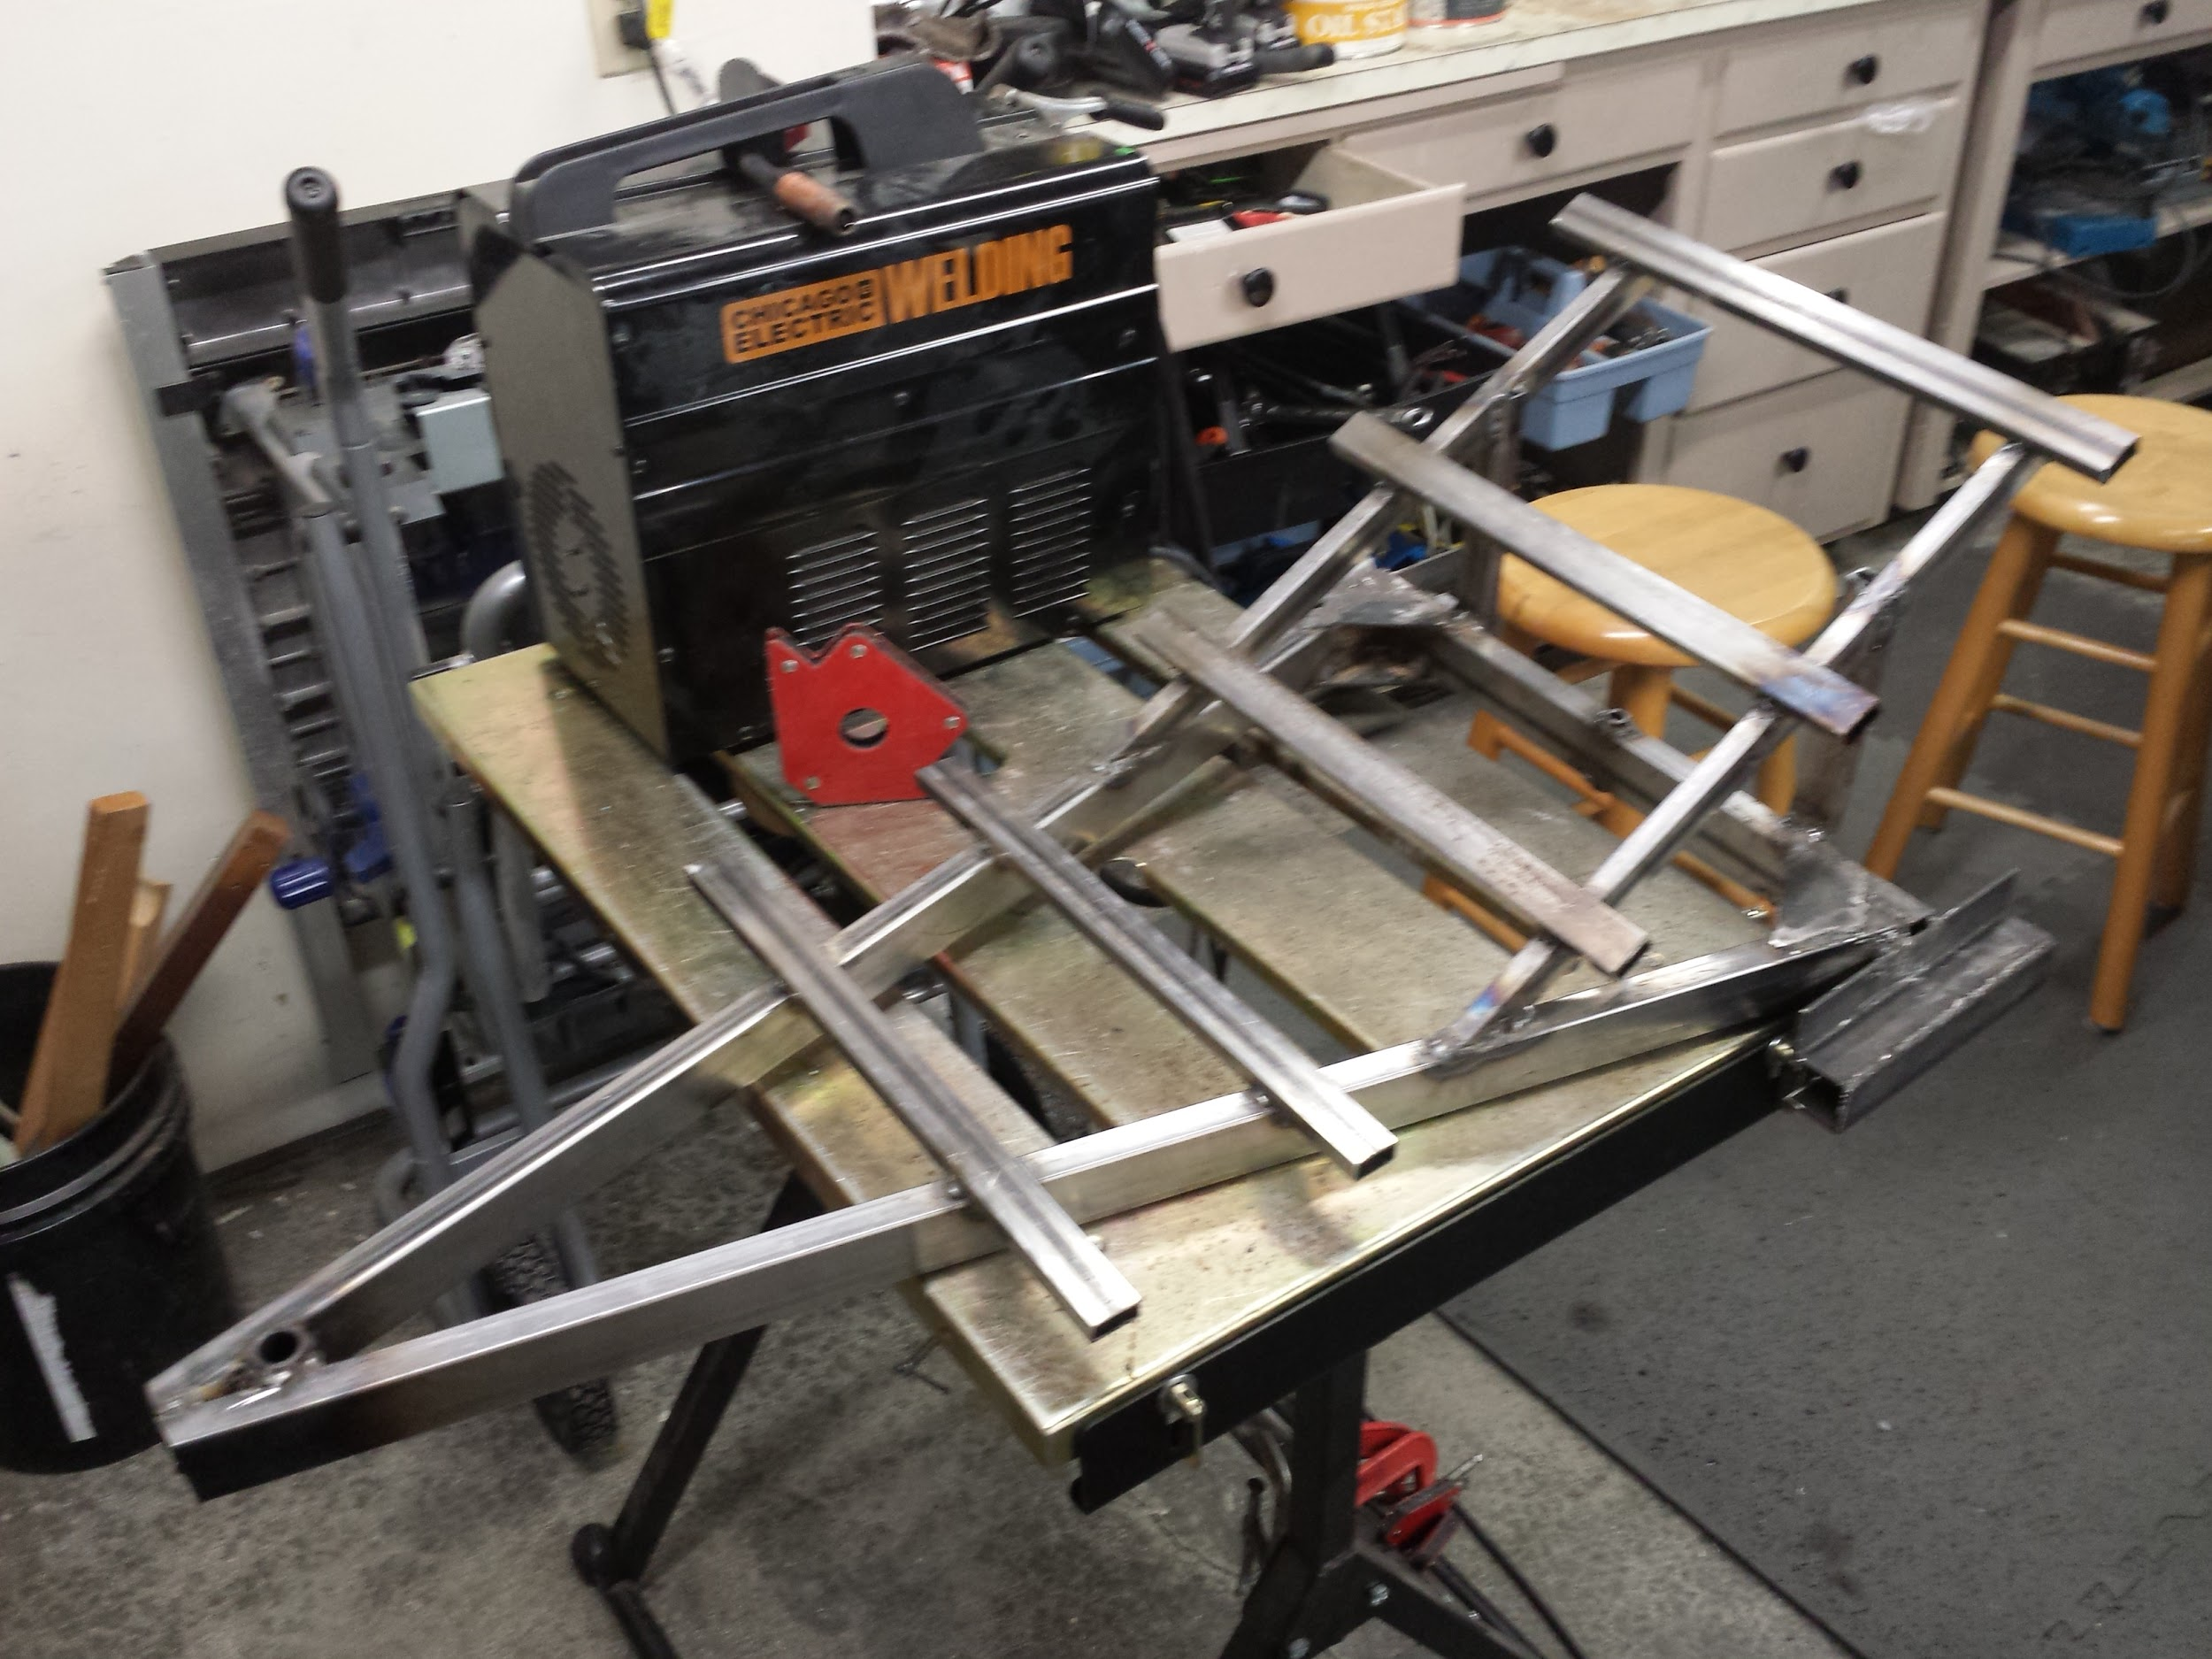
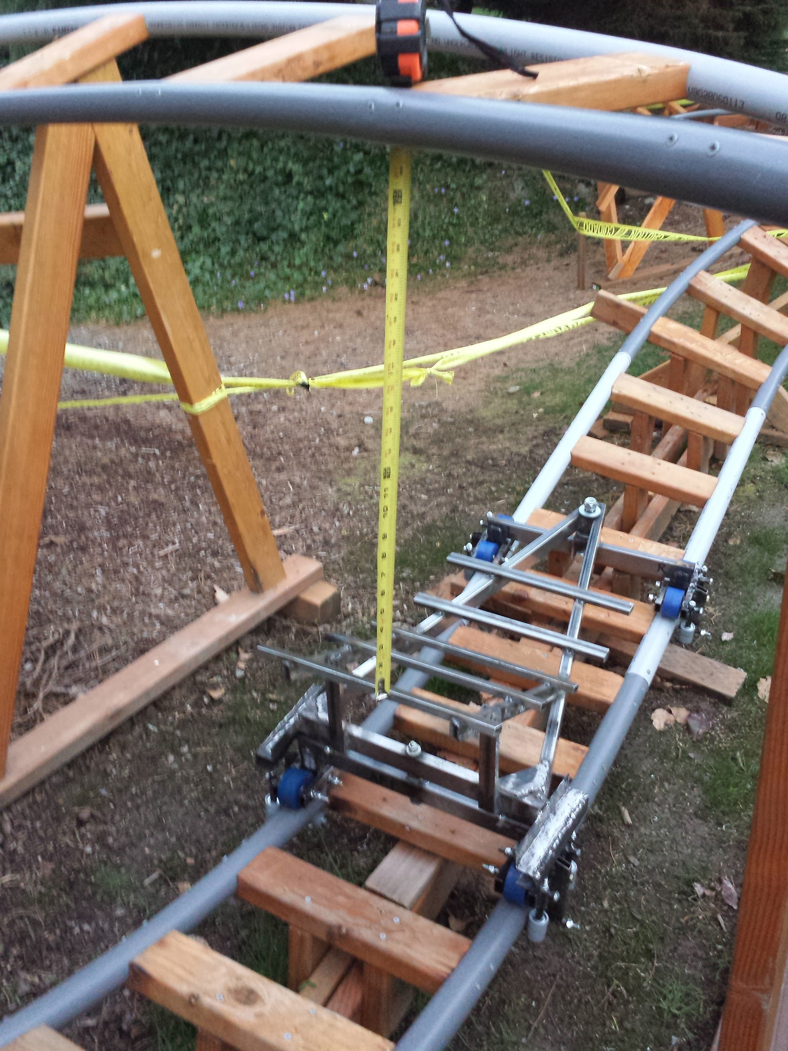
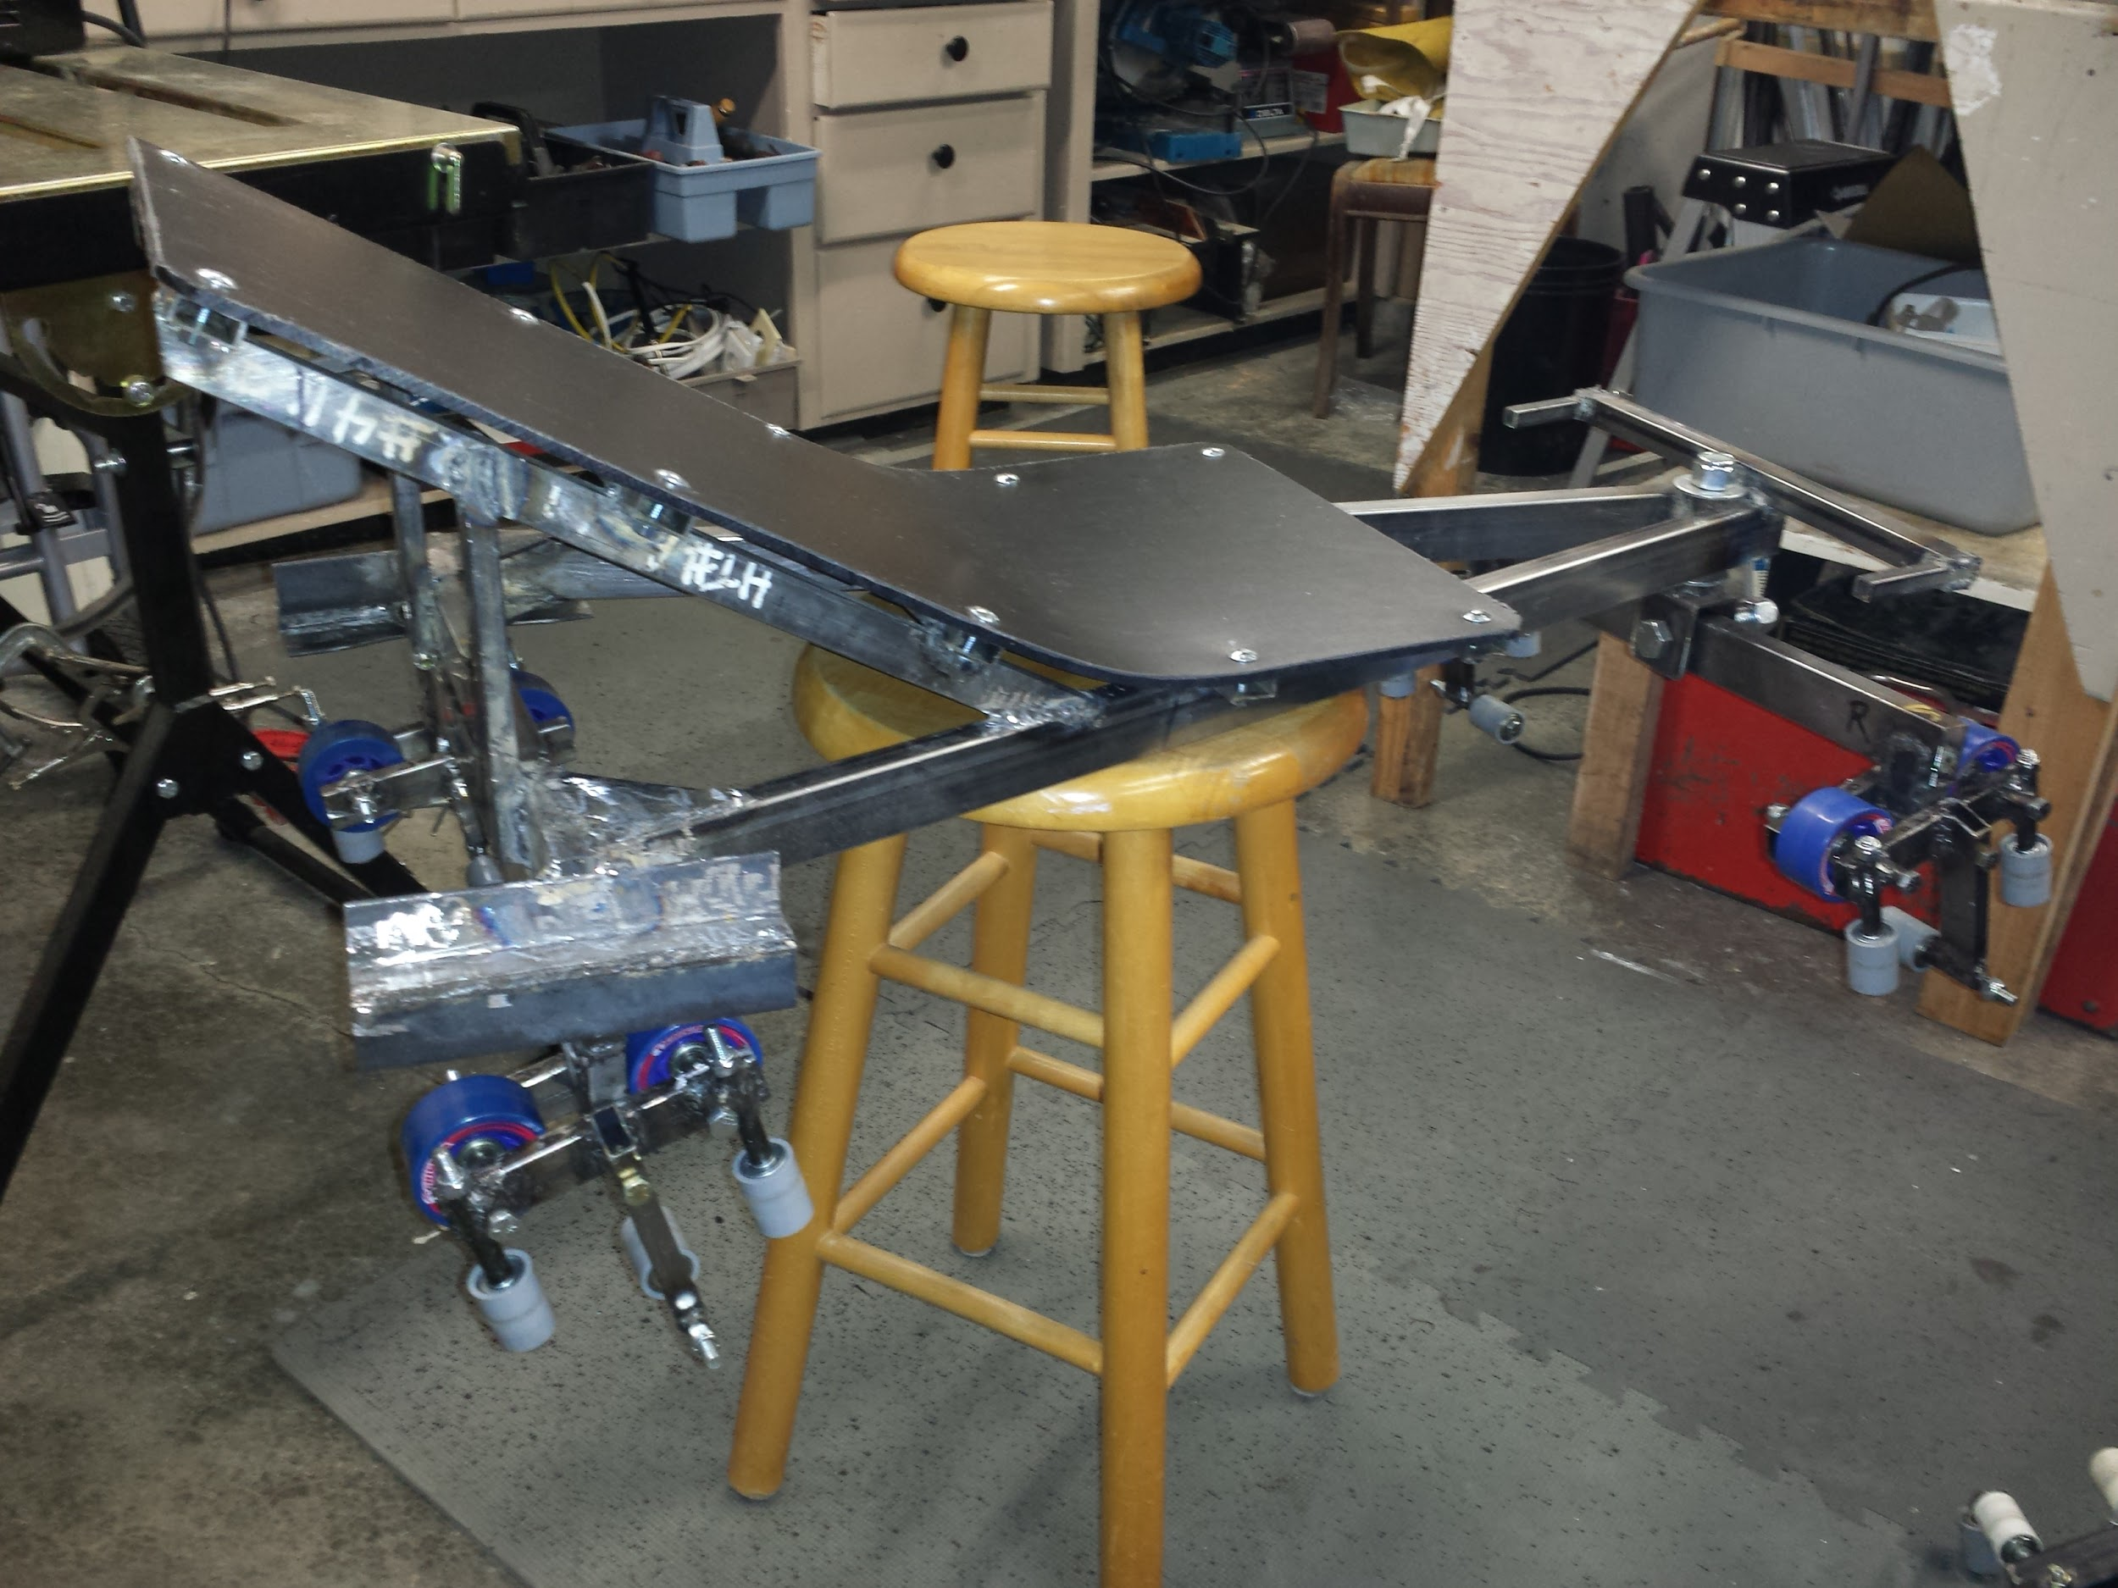
The higher BYRC-cart-3D-07 cart design necessitated a lower profile seat. This will also minimize the center of gravity.
welding low-profile seat frame
85 pound tests seemed fine
thermoformed plastic seat and foot rest
clearance 26 inches

Slide 21
On April 6th, 2015, we conducted a heavy cart test on the 3D-02 track with 230 pound of sandbags, successfully (no signs of permanent deflection or material cracking on cart or track.)
Assuming a 1.5 factor of safety on design limit load, this “qualifies” the coaster for a 153 pound rider.

Slide 22
What I learned:
I really like the concept of axle sleeves welded to square and rectangular framework, but it means a lot of welding.
I’m learning a lot about bearings. Close tolerance (high quality) ABEC 5+ bearings are probably better for main wheels, but side wheels might be better off with loose (cheap roller skate) bearings, which seem to spin up quicker.
I bought a small cutoff saw, because it has a thin blade, but the tolerances aren’t great. However, when cutting round tubes for axle spacers, when tolerances count, you can get a better square cut if you plunge the blade in a bit, then spin the tube. Really good spacer square ends require turning on a lathe.
I’m making my side and upstop wheels out of ¾ PVC conduit couplers, but they require a slight turning of the inside diameter to match the diameter of the bearing. I like the PVC because friction of PVC-to-PVC is low, and I can’t find small diameter, wide wheel.
Welding 0.063 rectangular, square, and round tubes is a little tricky, as you have to not overdo it, and watch for burn through. It helps to have an old bolt in the tube to carry some heat away and keep the inner shape.

Slide 23
Design changes for the next cart (BYRCcart-3D-08)
In high slope tracks, the front wheels of each truck rubbed on the welded doublers, so the doublers had to be ground down quite a bit. So I need to space the front wheels of each individual truck a little further from the axle.
The whole cart ended up higher than I would like, so the 08 cart should either go back to the horizontal bolt system of pre-04 designs, or the height should be designed lower some other way, maybe a joggled frame.
The aft channels designed to react the overturning roll moment loads don’t need to be so large. In fact, I believe that two (or four?)vertically spaced bearing rollers on an upstanding member of the bogie, sandwiched between a single arc’ed blade attached to the frame, could be an optimum solution. This will affect the lower-height goal.
I really need to get a better CAD program.

